Slide 1
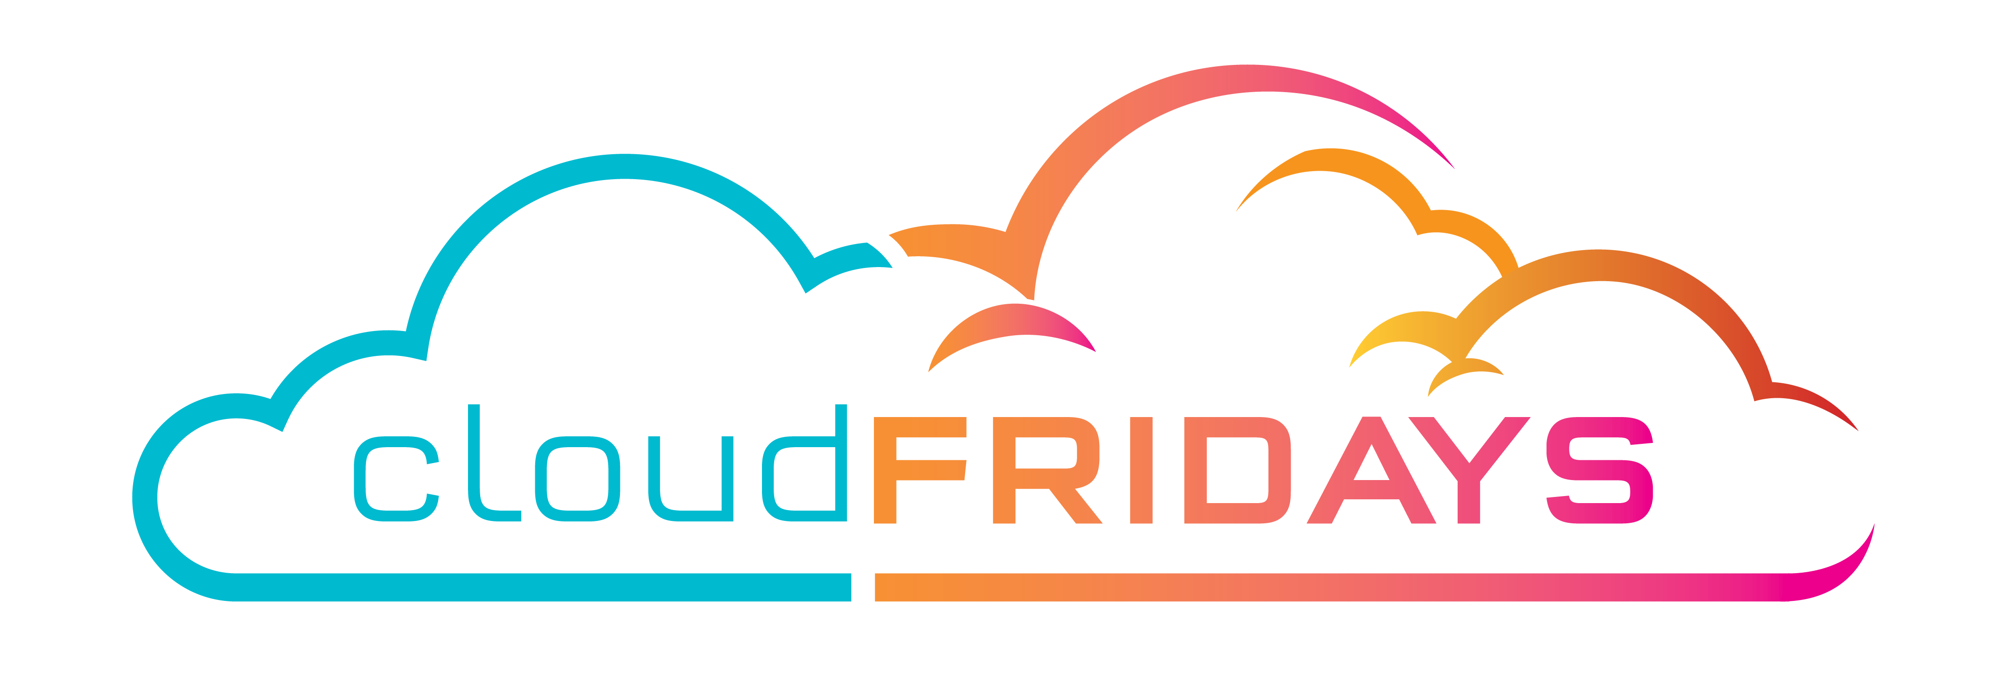

Solutions Available on Azure
Monitoring & Reporting
Thomas Van Niekerk

Slide 2
What’s UP?
Always wishing to know what is actually going on in your …
App
Program
Process
Profits
Business
…

Slide 3
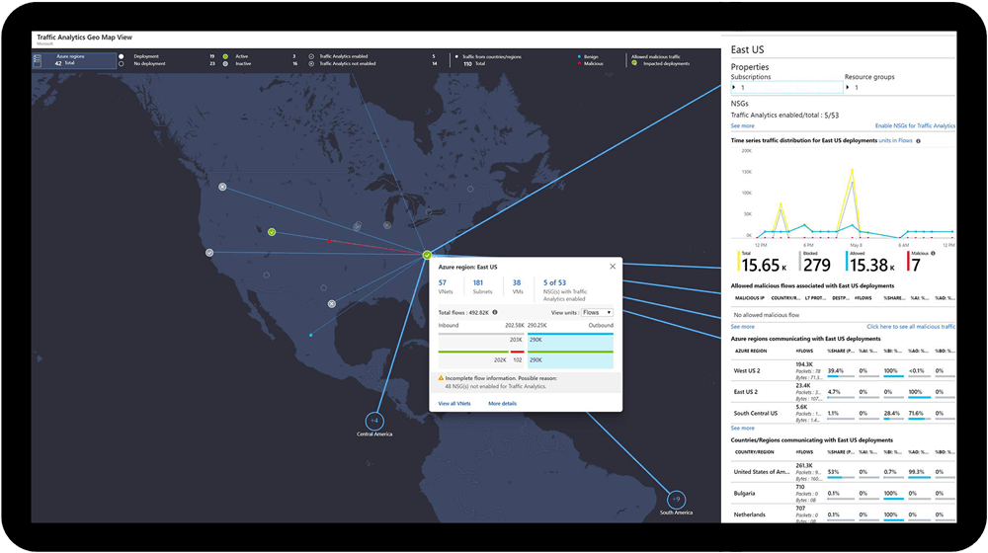
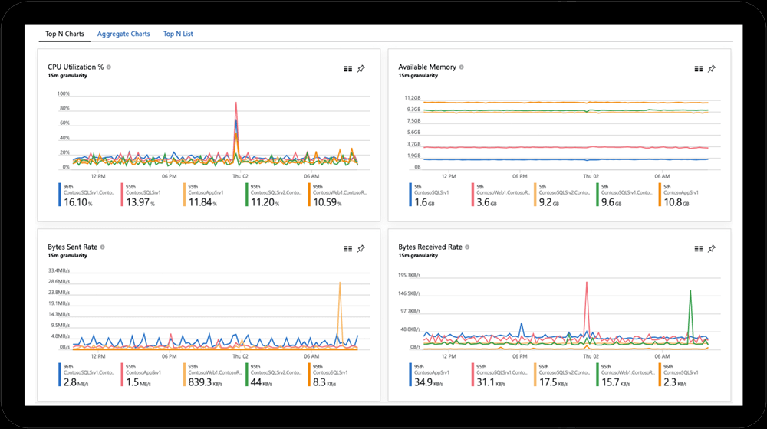
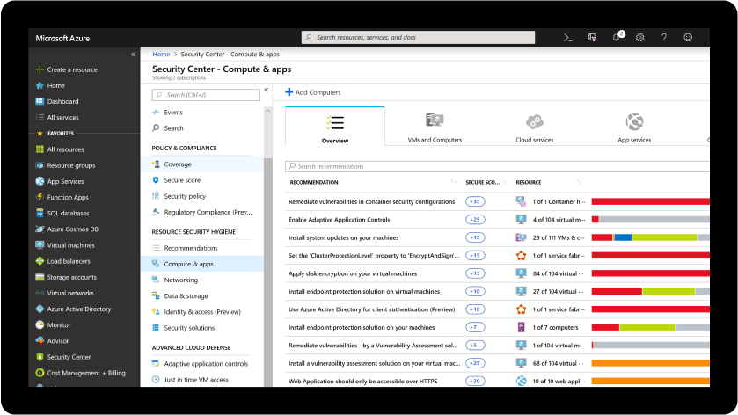
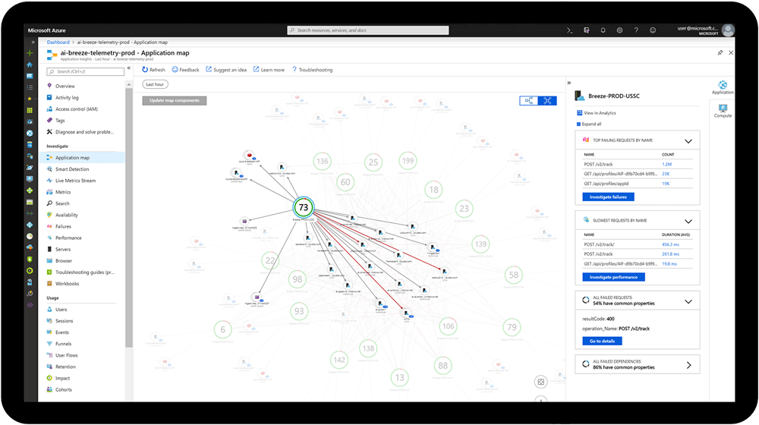
Notes:
Transform your business with modern monitoring
Collect, analyze, and act on telemetry data from your Azure and on-premises environments.
Azure Monitor helps you maximize performance and availability of your applications and proactively identify problems in seconds.

Slide 4
Why Monitoring & Reporting?
One can never improve on anything that is not measured.

Slide 5
What is Monitoring & Reporting?
Techniques that enables tools, devices or applications to monitor systems, processes or tasks.
When regular observation and recording of activities are taking place.
A process of routinely gathering information on all aspects of a system, application or project.
Reporting enriches the gathered information to be used in making decisions or gain insight on how to improve performance or take corrective actions.

Slide 6
Why Azure Monitoring
Maximizes the availability of applications and services
Maximizes the performance of applications and services
A Comprehensive solution for collecting, analysing, and acting on telemetry from cloud and on-premises environments

Slide 7
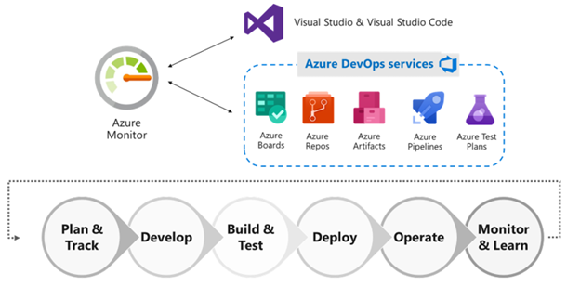
Continuous Monitoring with Azure Monitor
Continuous Integration and Continuous Deployment (CI/CD) is a DevOps concept.
Continuous Monitoring (CM)
Notes:
Can help you deliver software or solutions faster and more reliably to provide continuous value to your users/clients.
Continuous Monitoring (CM) is a new follow-up concept where you can incorporate monitoring across each phase of your DevOps and IT Ops cycles.
To ensures the health, performance, and reliability of your apps and infrastructure continuously as it flows through from developing, build, production and delivery phases unto your users & customers.

Slide 8
Best Practice for Continuous Monitoring
Enable monitoring for all your apps
Enable monitoring for all relevant components of your infrastructure
Bucket related resources in resource groups
Ensure quality through Continuous Deployment
Notes:
The first step for full observability is to enable monitoring across all your web apps and services.
It is usually difficult to predict what components of your application stack might have an issue, so it is important to monitor all the relevant components.
A typical application on Azure today consists of monolithic apps deployed on VMs/App Services or microservices. Many customers use resource groups to bucket all the resources that make up their applications, and if you use the same, Azure Monitor for resource groups provides a simple way to keep track of the health and performance of your entire full-stack application, while enabling you to drill down into respective components for any investigations or debugging.
Azure Pipelines is a great way to setup Continuous Deployment. One can automate the entire process from code commit to production if your CI/CD tests are successful. Integrating monitoring as part of your pre or post-deployment Azure Pipelines is a cloud service that you can use to automatically build and test your code project and make it available to other users. ... Azure Pipelines combines continuous integration (CI) and continuous delivery (CD) to constantly and consistently test and build your code and ship it to any target

Slide 9
Best Practice for Continuous Monitoring
Setup actionable alerts with notifications and/or remediation
Prepare role-based dashboards and workbooks for reporting
Continuously optimize with “Build-Measure-Learn”
Notes:
Having a robust alerting pipeline is essential for any monitoring strategy and it is recommended to set up actionable alerts for all predictable failure states. You could configure your alerts based on static or even dynamic thresholds and setup actions on top of them. These actions could be as simple as SMS, emails, push notifications or voice calls for simple notifications. You could even connect to your existing ITSM Tools
When I ask large groups of people in conference presentations, whether any of them already use the same monitoring solutions across dev and ops in their companies, the answer is overwhelmingly negative! For successful Continuous Monitoring and ensuring fast MTTD and MTTR Workbooks combine text, Analytics queries, Azure Metrics, and parameters into rich interactive reports. Workbooks are editable by any other team members who have access to the same Azure resources.
Building the right solution for your customers is never achieved in the first go and it is often an iterative process. Monitoring is one of the cornerstones of the popular “Build-Measure-Learn” philosophy which recommends continuously tracking your KPIs or user behavior metrics and striving to optimize them through planning iterations. With Azure Monitor, you can collect all the relevant custom events, metrics, or logs relevant to your business and it is extremely simple to add a new data point in the next deployment if something seems missing.

Slide 10
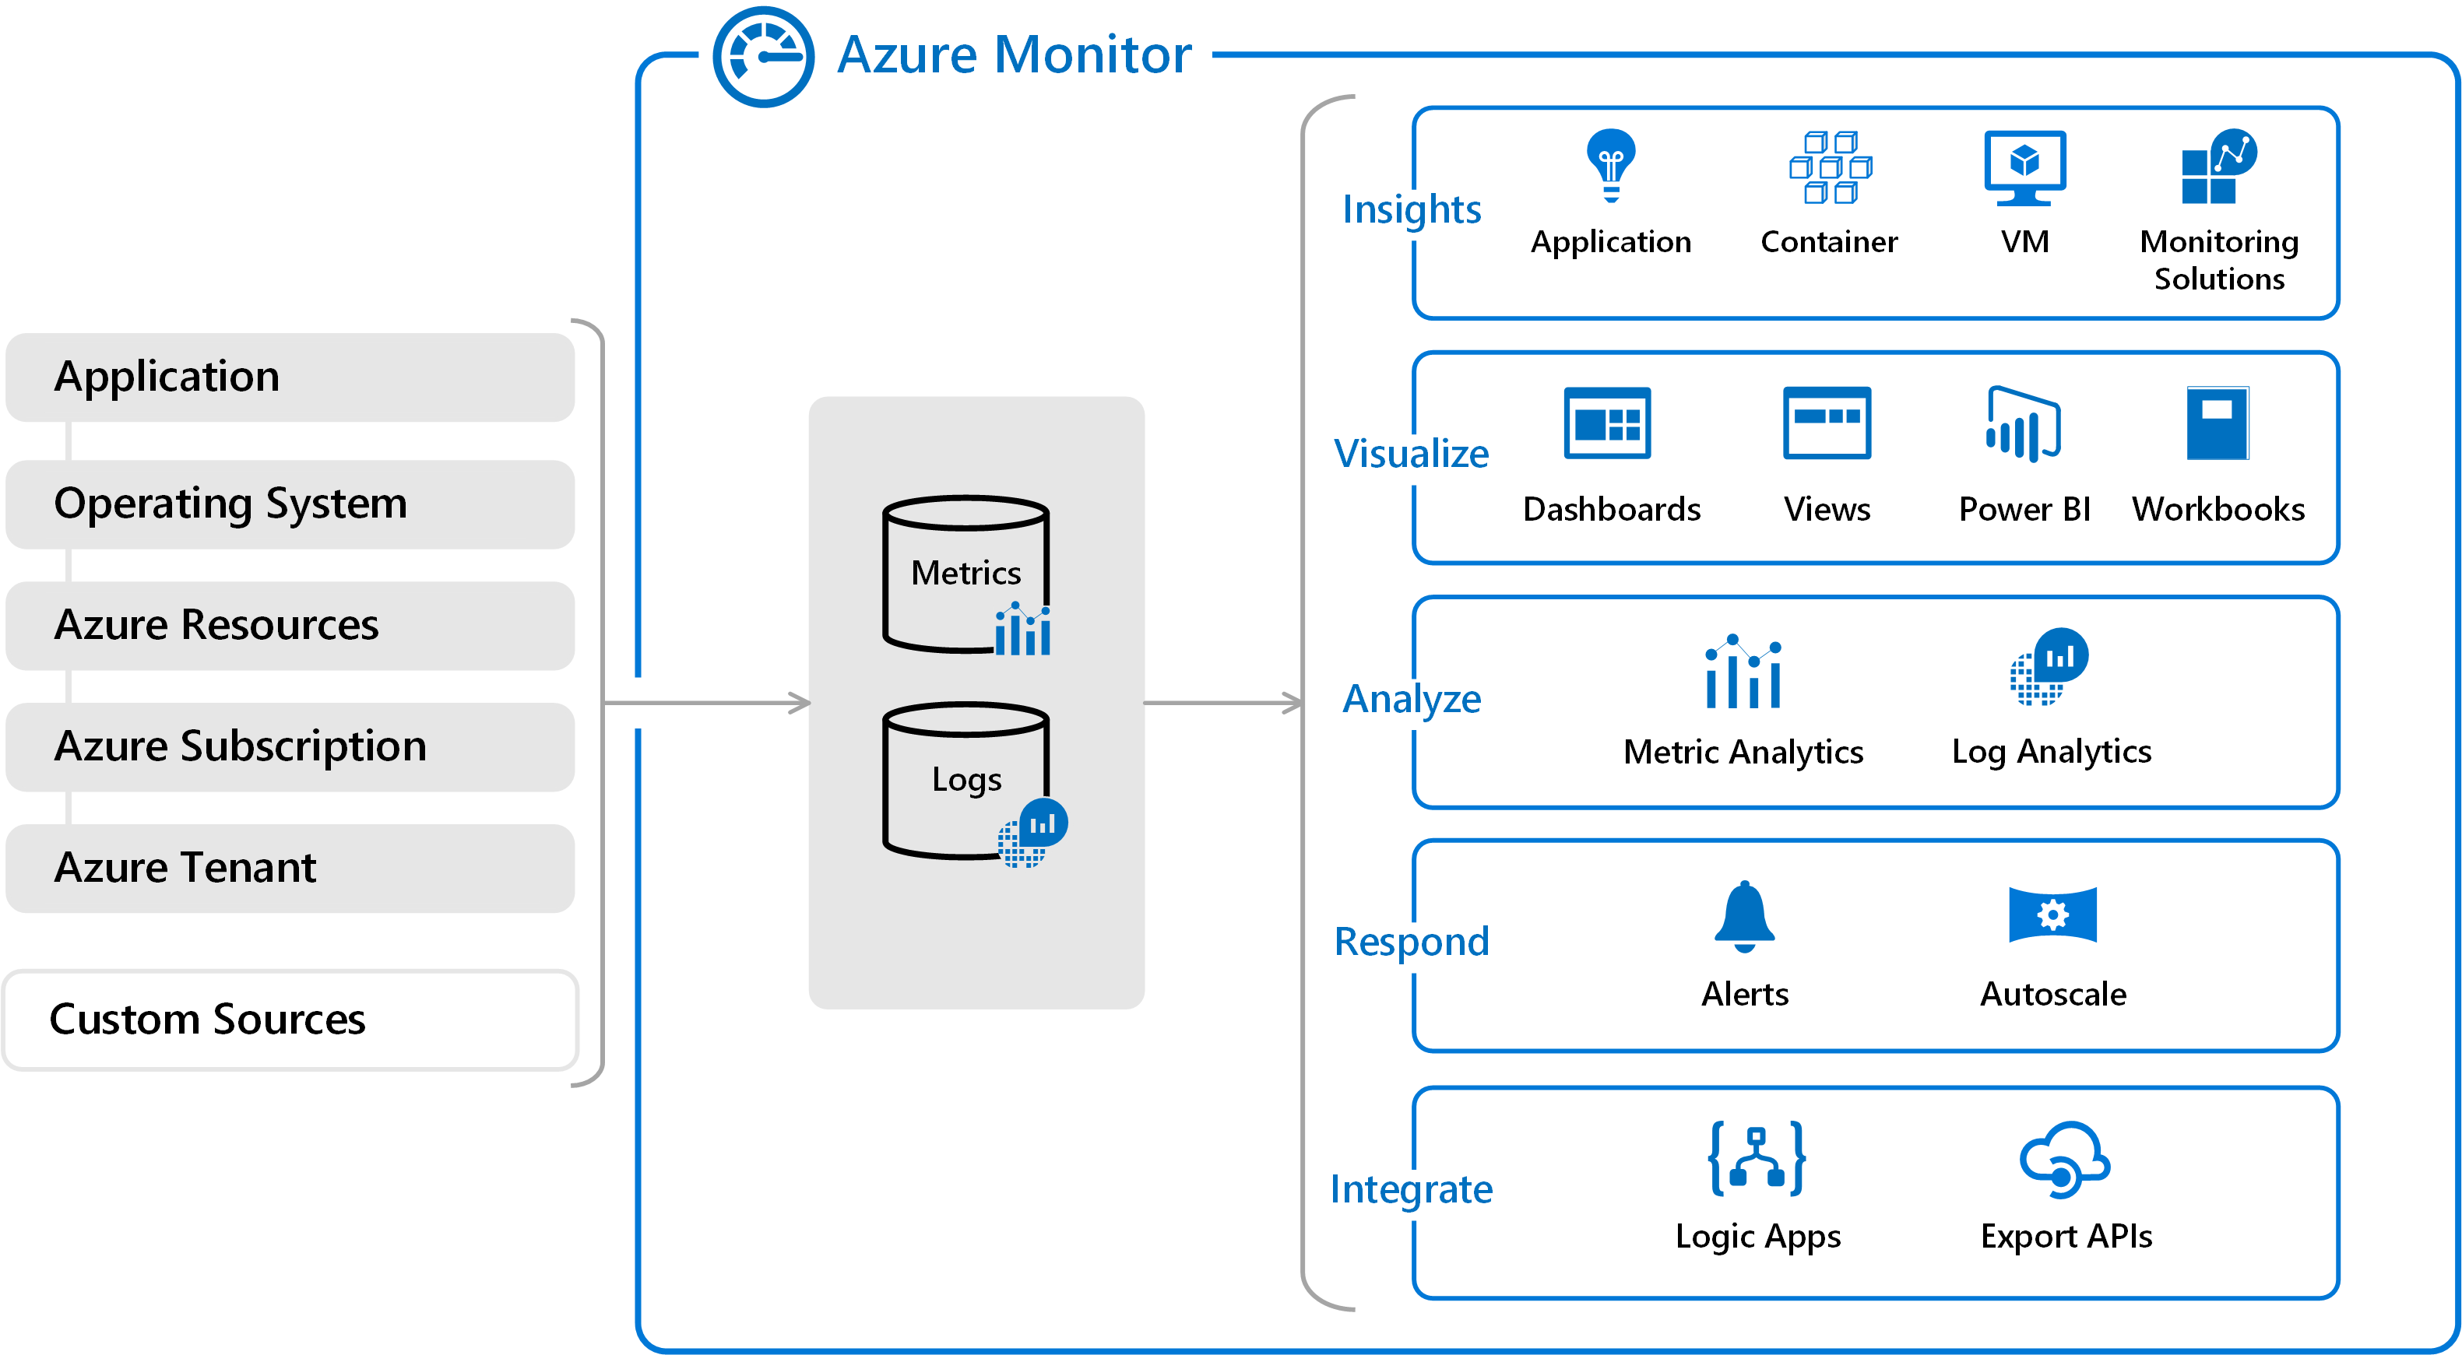
High-level view of Azure Monitor
Notes:
At the center of the diagram are the data stores for metrics and logs, which are the two fundamental types of data use by Azure Monitor.
On the left are the sources of monitoring data that populate these data stores.
On the right are the different functions that Azure Monitor performs with this collected data such as analysis, alerting, and streaming to external systems.

Slide 11
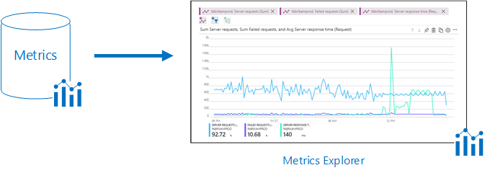
Monitoring data platform
Notes:
All data collected by Azure Monitor fits into one of two fundamental types, metrics and logs.
Metrics are numerical values that describe some aspect of a system at a particular point in time.
They are lightweight and capable of supporting near real-time scenarios.
Logs contain different kinds of data organized into records with different sets of properties for each type.
Telemetry such as events and traces are stored as logs in addition to performance data so that it can all be combined for analysis.

Slide 12
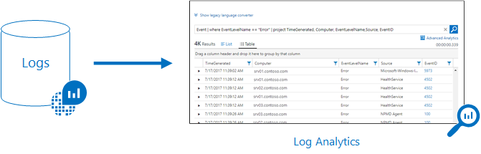
Monitoring data platform
Notes:
Log data collected by Azure Monitor can be analyzed with queries to quickly retrieve, consolidate, and analyze collected data.
You can create and test queries using Log Analytics in the Azure portal and then either directly analyze the data using these tools or save queries for use with visualizations or alert rules.
Azure Monitor uses a version of the Kusto query language used by Azure Data Explorer that is suitable for simple log queries
but also includes advanced functionality such as aggregations, joins, and smart analytics.
You can quickly learn the query language using multiple lessons. Particular guidance is provided to users who are already familiar with SQL and Splunk.

Slide 13
What data can Azure Monitor collect?
Application monitoring data
Guest OS monitoring data
Azure resource monitoring data
Azure subscription monitoring data
Azure tenant monitoring data
Notes:
Azure Monitor can collect data from a variety of sources. You can think of monitoring data for your applications in tiers ranging from your application, any operating system and services it relies on, down to the platform itself. Azure Monitor collects data from each of the following tiers:
Application monitoring data: Data about the performance and functionality of the code you have written, regardless of its platform.
Guest OS monitoring data: Data about the operating system on which your application is running. This could be running in Azure, another cloud, or on-premises.
Azure resource monitoring data: Data about the operation of an Azure resource.
Azure subscription monitoring data: Data about the operation and management of an Azure subscription, as well as data about the health and operation of Azure itself.
Azure tenant monitoring data: Data about the operation of tenant-level Azure services, such as Azure Active Directory. As soon as you create an Azure subscription and start adding resources such as virtual machines and web apps, Azure Monitor starts collecting data. Activity logs record when resources are created or modified. Metrics tell you how the resource is performing and the resources that it's consuming.
Extend the data you're collecting into the actual operation of the resources by enabling diagnostics and adding an agent to compute resources.
This will collect telemetry for the internal operation of the resource and allow you to configure different data sources to collect logs and metrics from Windows and Linux guest operating system.
Enable monitoring for your App Services application or VM and virtual machine scale set application, to enable Application Insights to collect detailed information about your application including page views, application requests, and exceptions. Further verify the availability of your application by configuring an availability test to simulate user traffic.
Custom sources
Azure Monitor can collect log data from any REST client using the Data Collector API. This allows you to create custom monitoring scenarios and extend monitoring to resources that don't expose telemetry through other sources.

Slide 14
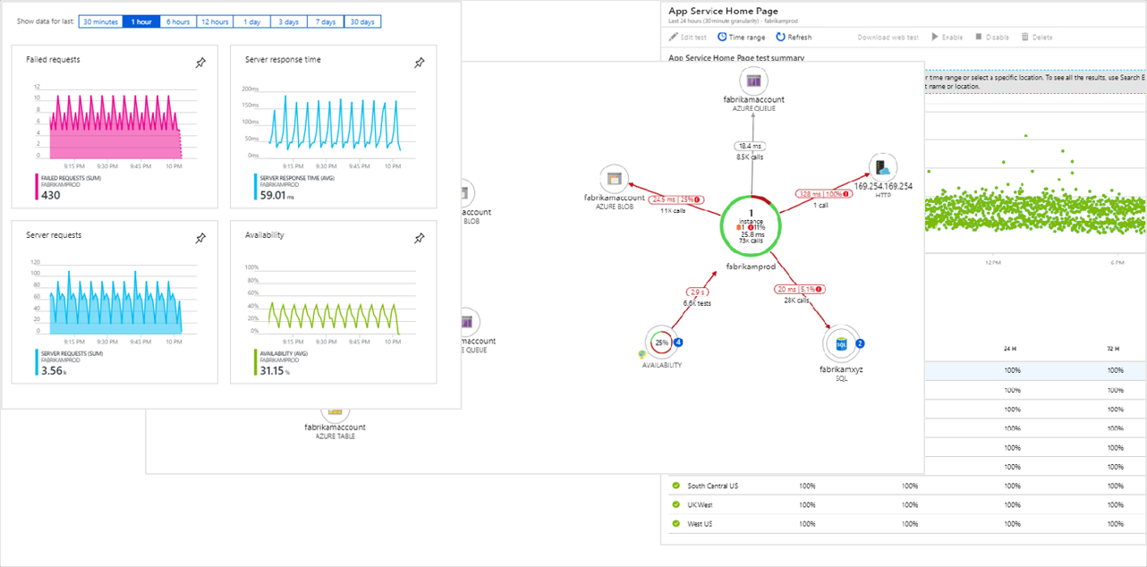
Application Insights
Notes:
Insights
Monitoring data is only useful if it can increase your visibility into the operation of your computing environment.
Azure Monitor includes several features and tools that provide valuable insights into your applications and other resources that they depend on.
Monitoring solutions and features such as Application Insights and Azure Monitor for containers provide deep insights into different aspects of your application and specific Azure services.
Application Insights
Application Insights monitors the availability, performance, and usage of your web applications whether they're hosted in the cloud or on-premises.
It leverages the powerful data analysis platform in Azure Monitor to provide you with deep insights into your application's operations and diagnose
errors without waiting for a user to report them.
Application Insights includes connection points to a variety of development tools and integrates with Visual Studio to support your DevOps processes.

Slide 15
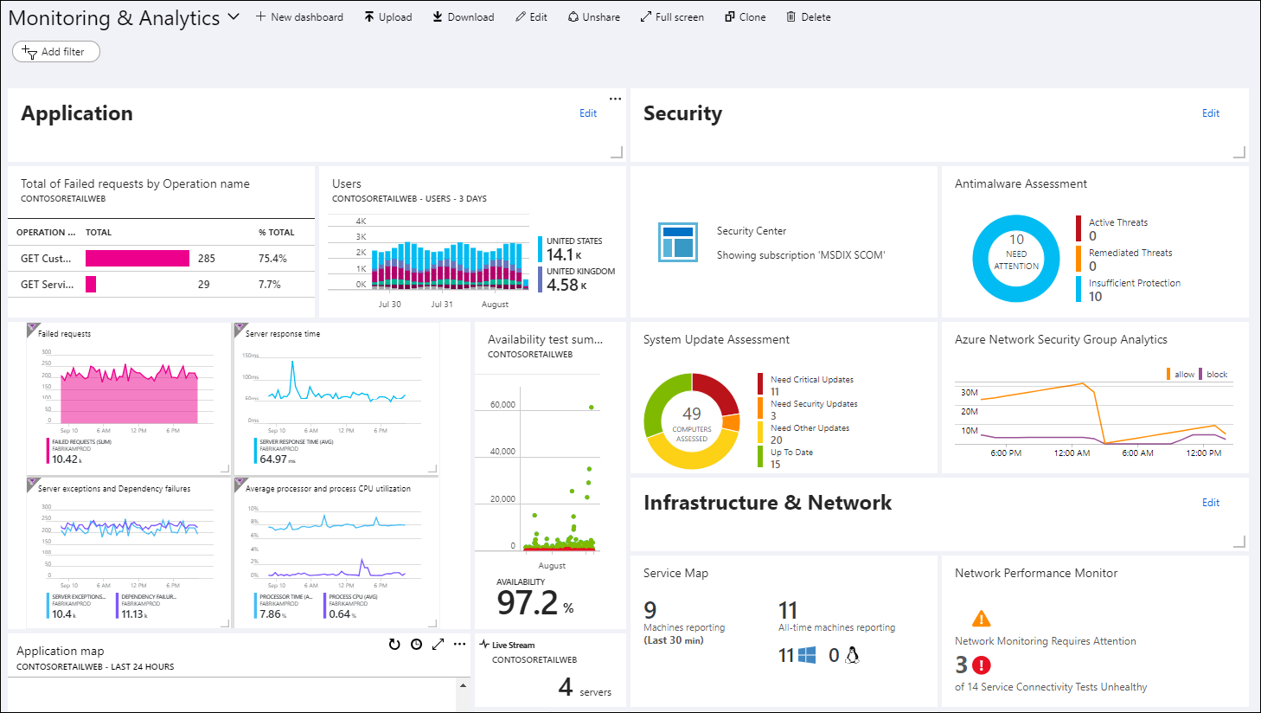
Dashboards
Notes:
Visualizing monitoring data
Visualizations such as charts and tables are effective tools for summarizing monitoring data and presenting it to different audiences.
Azure Monitor has its own features for visualizing monitoring data and leverages other Azure services for publishing it to different audiences.
Dashboards
Azure dashboards allow you to combine different kinds of data, including both metrics and logs, into a single pane in the Azure portal.
You can optionally share the dashboard with other Azure users. Elements throughout Azure Monitor can be added to an
Azure dashboard in addition to the output of any log query or metrics chart. For example, you could create a dashboard that combines
tiles that show a graph of metrics, a table of activity logs, a usage chart from Application Insights, and the output of a log query.

Slide 16
Azure Monitor Pricing
Log Analytics
Data Ingestion
Capacity Reservations
CAPACITY¹ | PRICE | DISCOUNT OVER PAY-AS-YOU-GO
100 GB per day | $219.52 per day | 15%
200 GB per day | $412.16 per day | 20%
300 GB per day | $604.80 per day | 22%
400 GB per day | $788.48 per day | 23%
500 GB per day | $968.80 per day | 25%
More than 500 GB per day | $968.80 per day + $193.76 per day for each 100 GB increment after 500 GB in daily capacity | 25%
https://azure.microsoft.com/en-us/pricing/details/monitor/
Notes:
Log Analytics
For Azure Monitor Log Analytics, you pay for data ingestion and data retention.
Data Ingestion
There are two ways to pay for ingesting data into the Azure Monitor Log Analytics service: Capacity Reservations and Pay-As-You-Go.
Capacity Reservations
With Capacity Reservations you are billed a fixed predictable fee based on your selected capacity reservation for ingesting data.
Capacity Reservations provide you a discount (up to 25%) on data ingestion based on your selected capacity reservation compared to
Pay-As-You-Go pricing. You have the flexibility to opt out of the capacity tier any time after the first 31 days of commitment.
Pay-As-You-Go
With Pay-As-You-Go pricing, you are billed per gigabyte (GB) of data ingested into the Log Analytics workspace.
FEATUREFREE UNITS INCLUDEDPRICEData Ingestion5 GB per billing account per month³$2.76 per GB³The first 5 GB of data ingested per organization to the Azure Monitor Log Analytics service every month is offered free.
Data Retention
Every GB of data ingested into your Azure Monitor Log Analytics workspace can be retained at no charge for up to first 31 days. Data retained beyond first 31 days will be charged per the data retention prices listed below.
FEATUREFREE UNITS INCLUDEDPRICEData Retention31 days⁴$0.12 per GB per month⁴For Azure Sentinel enabled workspaces the data is retained for free for 90 days.

Slide 17
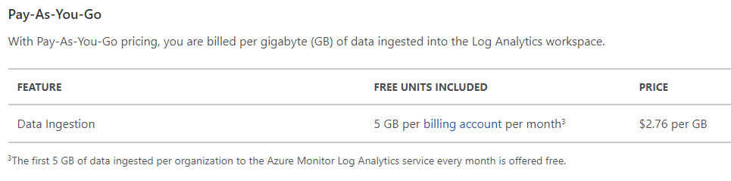
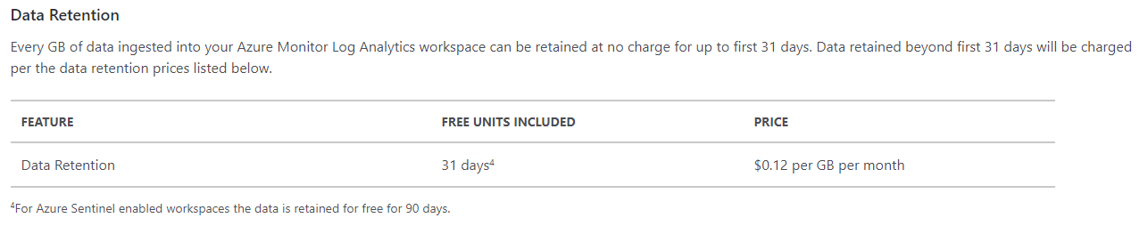
Azure Monitor Pricing
https://azure.microsoft.com/en-us/pricing/details/monitor/

Slide 18
Azure Monitor – Next Steps
Learn more about Azure Monitor in here: https://aka.ms/MonitoringDocs
Check out some good tutorials and videos within Azure Monitor Overview in the Azure Portal https://aka.ms/AzMonOverview
Learn more about:
Metrics and logs
Data sources
Log queries
Best practices
Notes:
A Continuous Monitoring pipeline across your apps and infrastructure throughout your DevOps and IT Ops processes can really help you reduce MTTD and MTTR while ensuring that you strive towards delivering the best solution for your customers
to assist you implementing some of these practices in further detail.
Next steps
Learn more about:
Metrics and logs for the data collected by Azure Monitor.
Data sources for how the different components of your application send telemetry.
Log queries for analyzing collected data.
Best practices for monitoring cloud applications and services.

Slide 19
THANK YOU!
Monitoring & Reporting
Thomas Van Niekerk

